Slide 1
Networks & Choice Modeling
Andrey Risukhin
University of Washington
June 8, 2021

Slide 2
How to Spend Resources
People have limited resources
Time
Budget
How do you choose what to spend on?
Rational decision maker
“Maximizing Utility” for individual
Example scenarios
Whether to join the DRP program
Which item on the lunch menu
Notes:
Rational to maximize reward from spending resources

Slide 3
How to Hire Faculty
Universities have limited resources
Budget
How does one choose who to hire?
“Maximizing Utility” for group interests
Consistency
Use a proxy?
USN Rank
Publication count
An algorithm?
Notes:
Imagine if there were an algorithmic way to make good choices

Slide 4
Outline
Inter-university faculty hiring data
Algorithms to discover inherent ranking
Discrete Logit
PageRank
SpringRank
Assess the models

Slide 5
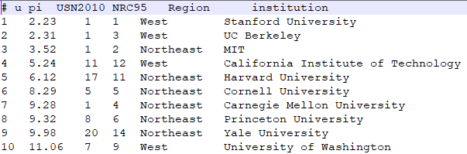
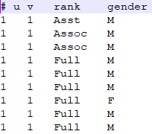
Faculty Hiring
206 universities (vertices)
Features (region, USN)
USN rank may be duplicate or missing
4989 hires (edges)
Directed (u hires from v)
Can have self loops
Features (rank, gender)
Choices & Network Ranks represented
Stanford
MIT
UW
Wright SU
Data: Copyright 2000-2017, Aaron Clauset
Notes:
Link https://aaronclauset.github.io/facultyhiring/

Slide 6
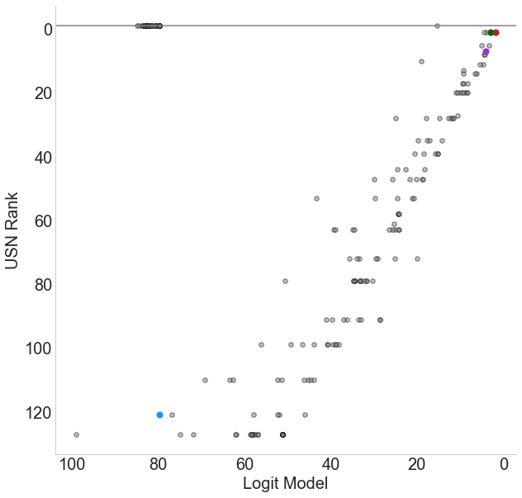
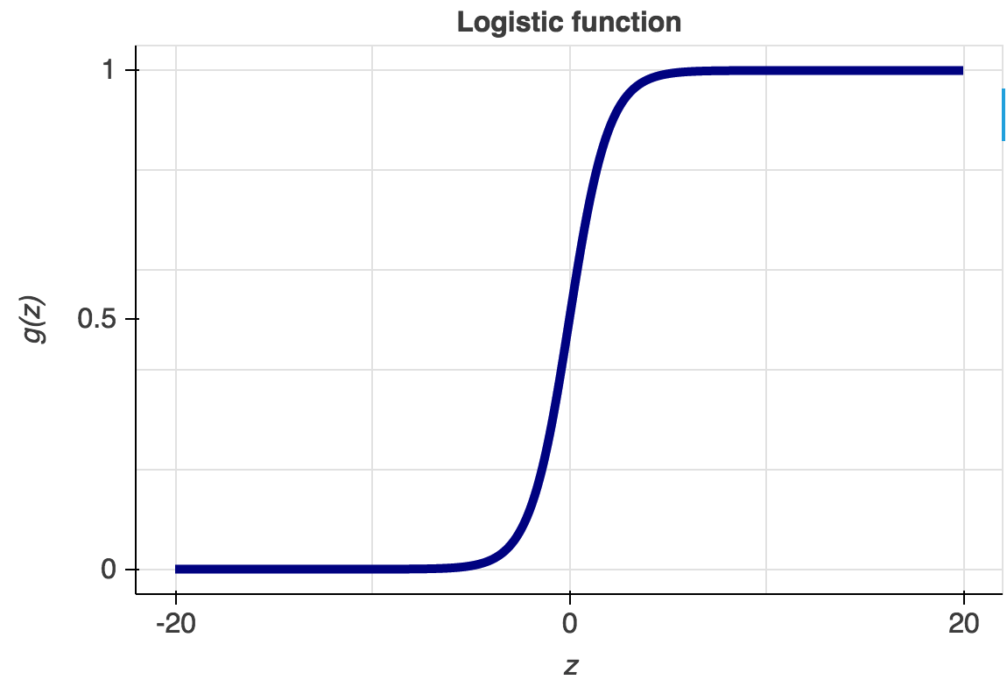
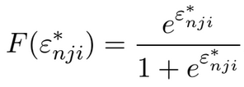
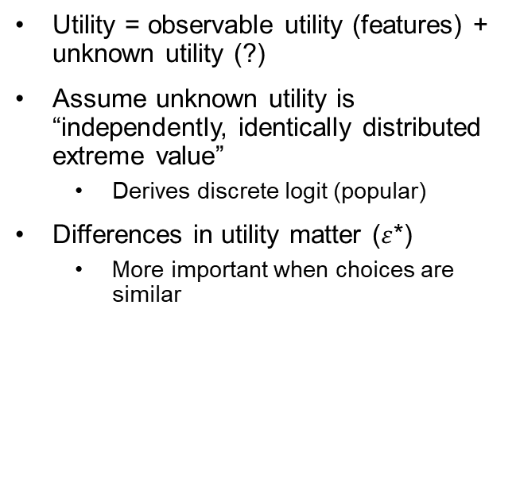
Discrete Logit
Utility = observable utility (features) + unknown utility (?)
Assume unknown utility is “independently, identically distributed extreme value”
Derives discrete logit (popular)
Differences in utility matter ($ε$*)
More important when choices are similar

Slide 7
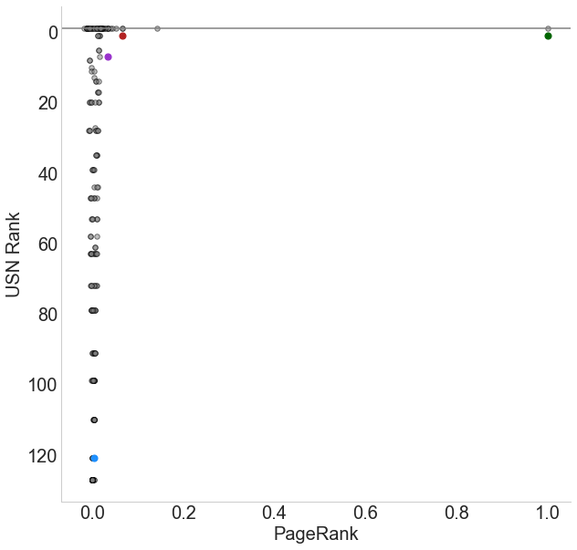
PageRank
Use connections between universities as ranking
Works for the internet, Google PageRank uses links
Linear algebra extracts intrinsic ranks (eigenvalues) from the graph
Eigenvalues are not interpretable

Slide 8
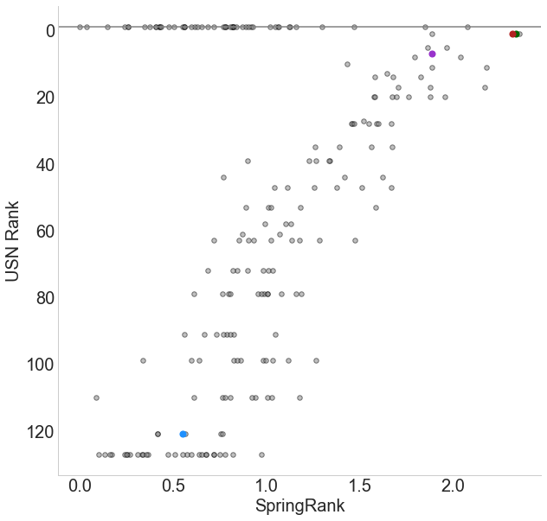
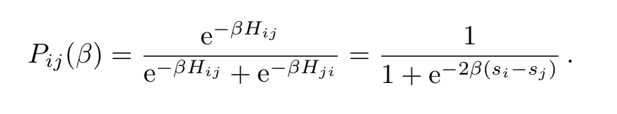
SpringRank
Use connections between universities as “springs”, minimize “energy” of network
Nice interpretation in terms of log(odds)
Probability that an edge goes from i to j (i beats j in competition
)
(nodes embedded in real-valued position/rank)

Slide 9
Summary
Algorithm Rankings
1. Stanford
2. MIT
3. UW
4. Wright State University
Discrete Logit | PageRank | SpringRank
Needs features & edges | Uses only edges | Uses only edges
Interpretable (log odds) | Not interpretable | Interpretable (log odds)

Slide 10
Acknowledgements
Mentor Aparajithan (Apara) Venkateswaran
SPA DRP for opportunity
Larremore Lab for SpringRank code
Aaron Clauset, Samuel Arbesman, and Daniel B. Larremore for faculty hiring dataset
Notes:
Aaron Clauset, Samuel Arbesman, and Daniel B. Larremore for faculty hiring dataset

Slide 11
Extra: Logit IID Extreme Value assumption
assumption that ε is distributed iid extreme value for all i. “unobserved factors are uncorrelated over alternatives, as well as having the same variance for all alternatives”
This assumption, while restrictive, provides a very convenient form for the choice probability (logistic)
assumption of independence can be inappropriate in some situations. Unobserved factors related to one alternative might be similar to those related to another alternative.
For example, a person who dislikes travel by bus because of the presence of other riders might have a similar reaction to rail travel; if so, then the unobserved factors affecting bus and rail are correlated rather than independent.
Logit model is applied to sequences of choices over time

